Slide 1
Graphical Models
Huijun Di
ajon@bit.edu.cn

Slide 2
Outline
Introduction
Generative Models
Bayesian Network (BN)
Markov Random Field (MRF)
Sequential Models: HMM, DBN
Discriminative Models
Conditional Random Field (CRF)
Max-margin Markov Networks
Summary

Slide 3
Introduction
What is Graphical Model
The catagories of Graphical Model
In terms of the graph representation
In terms of modeling direction

Slide 4
Graphical Model
Graphical Model:
+
Provides a natural tool for two problems:
Uncertainty and Complexity
Plays an important role in the design and analysis of machine learning algorithms
Probability Theory
Graph Theory

Slide 5
Graphical Model
Modularity: a complex system is built by combining simpler parts.
Probability theory: ensures consistency, provides interface models to data.
Graph theory: intuitively appealing interface for humans, efficient general purpose algorithms.

Slide 6
Graphical Model
Many of the classical multivariate probabilistic systems are special cases of the general graphical model formalism:
-Mixture models
-Factor analysis
-Hidden Markov Models
-Kalman filters
The graphical model framework provides a way to view all of these systems as instances of common underlying formalism.

Slide 7
Introduction
What is Graphical Model
The catagories of Graphical Model
In terms of the graph representation
In terms of modeling direction

Slide 8
Graph Representation
Graphical representation of probabilistic relationship between a set of random variables.
Variables are represented by nodes.
Binary events
Discrete variables
Continuous variables
x
z
Conditional (in) dependency is represented by (missing) edges.
Directed Graphical Model: (Bayesian network)
Directed edges give causality relationships
Undirected Graphical Model: (Markov Random Field)
Undirected edges simply give correlations between variables
Combined: chain graph
y
u
w
s
v

Slide 9
Modeling direction
Probability models
Generative probability models
P(image, foreground, background) designed by human
Discriminative probability models
P(class|image) obtained from data
Proceeding manner
Explaining model
Make a decision
Hypotheses
Candidates
Test/Fit: Low-level cues
Induce: Low-level cues
Top-down: Model-Driven
Bottom-up: Data-Driven

Slide 10
Generative vs. Discriminative
Generative model
Provides a way to explain the input
Generates the sample of possible observed data.
Relatively straightforward to characterize invariances
Discriminative model
Provides a way to compute the posterior distribution directly over a “target”,
In contrast to generative models, discriminative models do not provide a way of generating the training data.
They use the flexibility of the model in relevant regions of input space

Slide 11
Outline
Introduction
Generative Models
Bayesian Network (BN)
Markov Random Field (MRF)
Sequential Models: HMM, DBN
Discriminative Models
Conditional Random Field (CRF)
Max-margin Markov Networks
Summary

Slide 12
Bayesian Network (BN)
Introduction
Pictorial Structures for Object Recognition
Topic Models (PRML05_Topic Models.pdf)

Slide 13
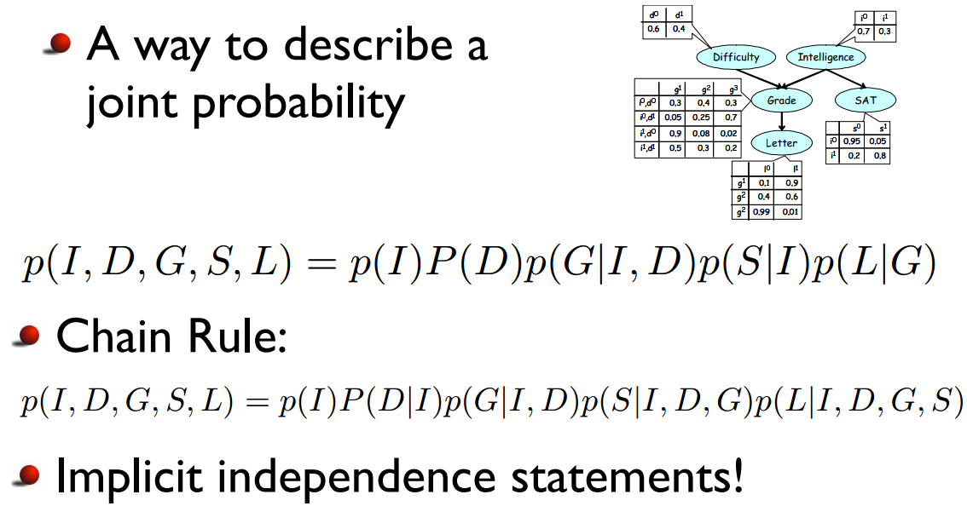
Bayesian Network (BN)
Directed Graphical Model
Directed edges give causality relationships

Slide 14
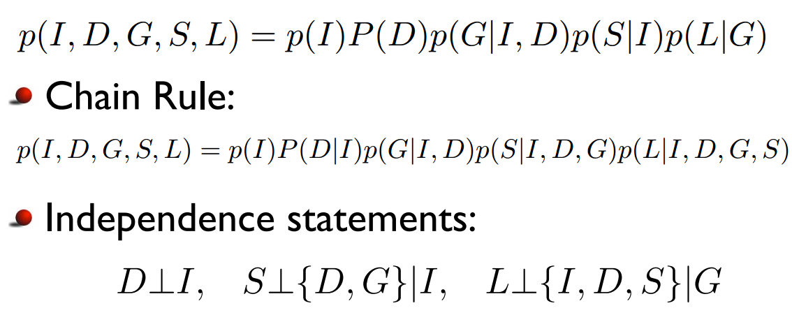
Bayesian Network (BN)

Slide 15
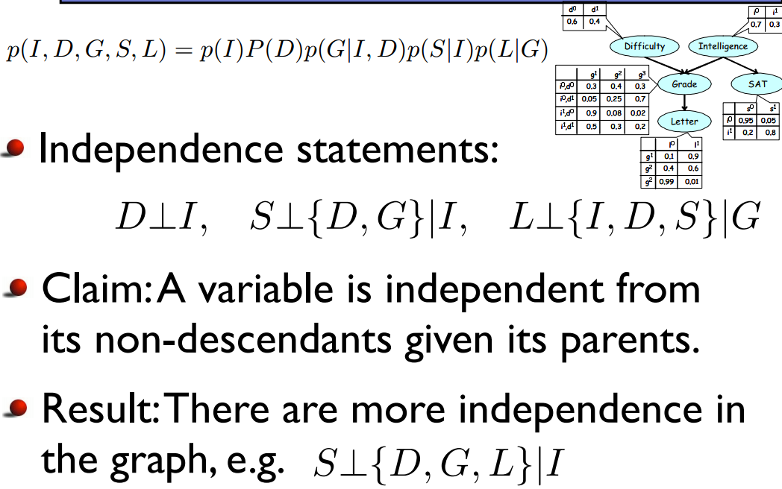
Bayesian Network (BN)

Slide 16
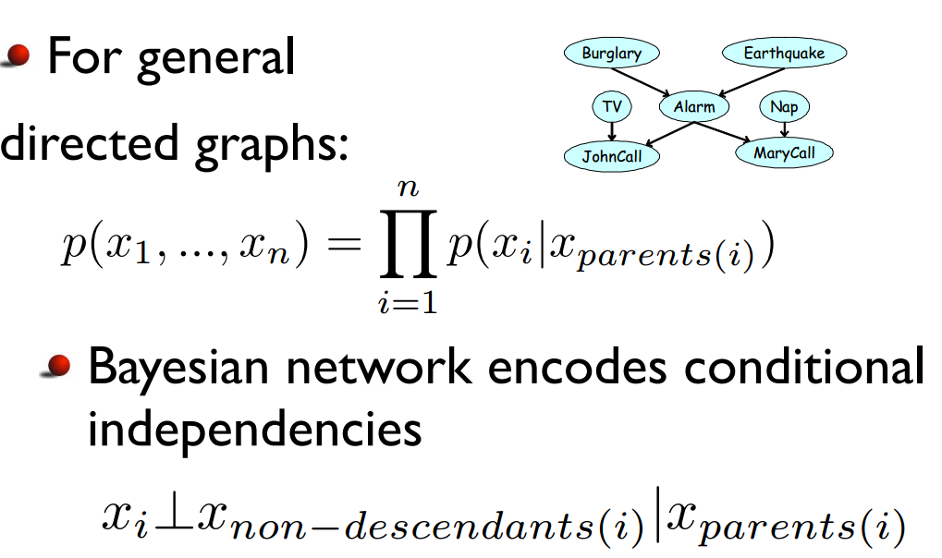
Bayesian Network (BN)

Slide 17
Bayesian Network (BN)
Introduction
Pictorial Structures for Object Recognition
Topic Models (PRML05_Topic Models.pdf)

Slide 18
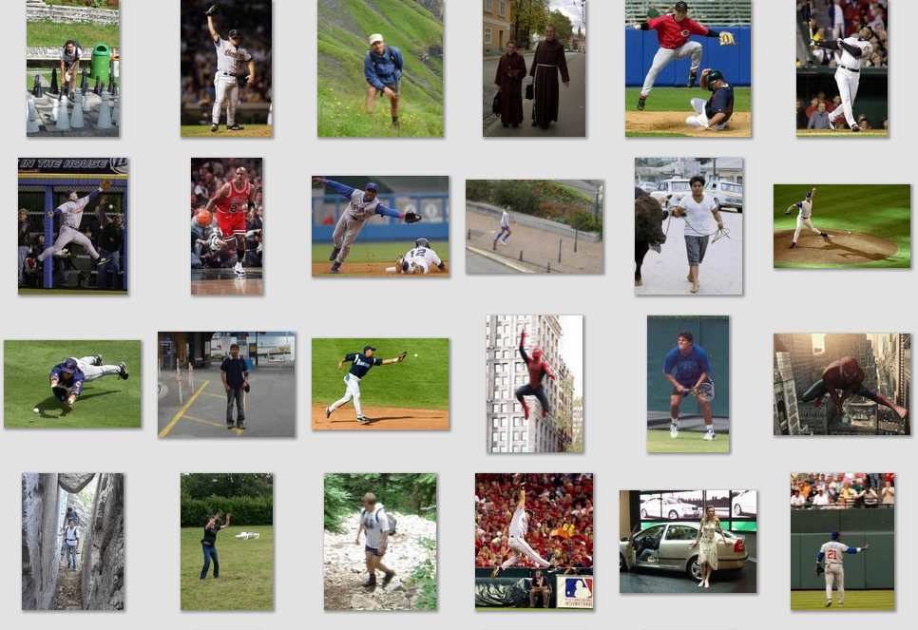
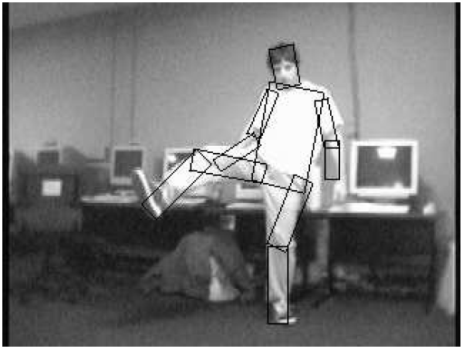
Pictorial Structures for Object Recognition
Deformable
High intra-class variations
Part-based model
Part-based representation: Objects are decomposed into parts and spatial relations among parts

Slide 19
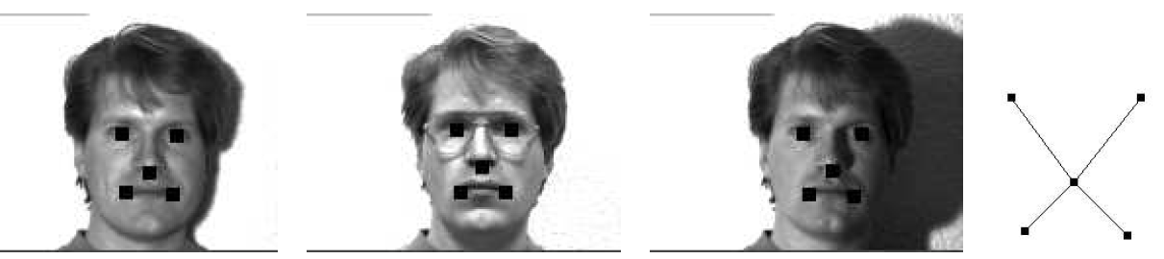
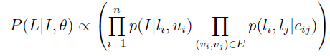
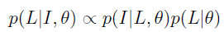
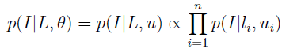
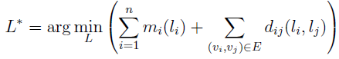
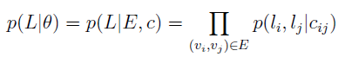
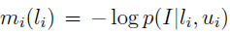
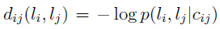
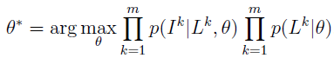
Pictorial Structures for Object Recognition
L₂
L₃
L₁
L₄
L₅
Z₂
Z₄
Z₁
Z₅
Z₃
Inference:
Learning:

Slide 20
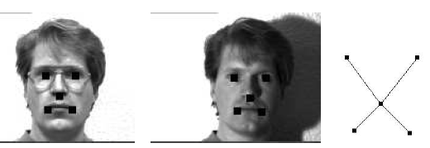
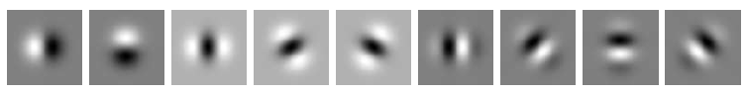
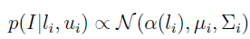
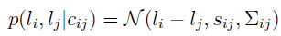
Pictorial Structures: Face models
L₂
L₃
L₁
L₄
L₅
Z₂
Z₄
Z₁
Z₅
Z₃

Slide 21
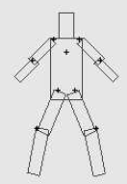
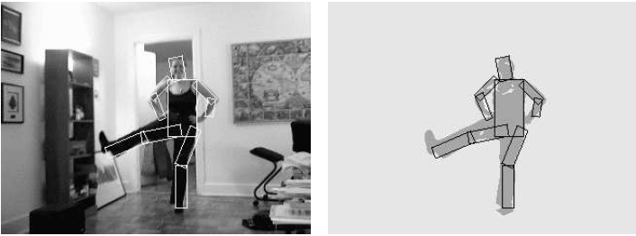
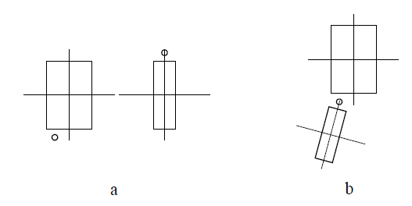
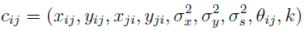
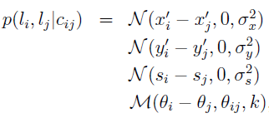
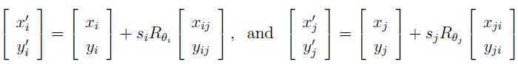
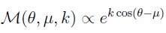
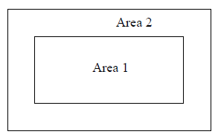
Pictorial Structures: Articulated Models
von Mises distribution
Foreground/background competition
favors large parts

Slide 22
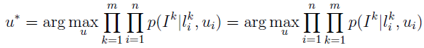
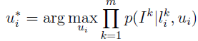
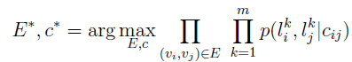
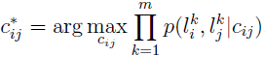
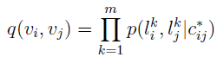
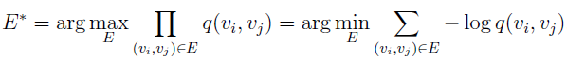
Pictorial Structures: Learning
L₂
L₃
L₁
L₄
L₅
Z₂
Z₄
Z₁
Z₅
Z₃
Learning:

Slide 23
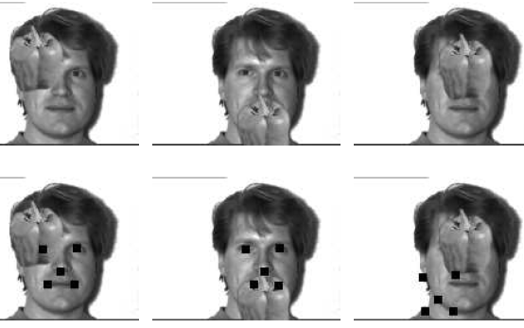
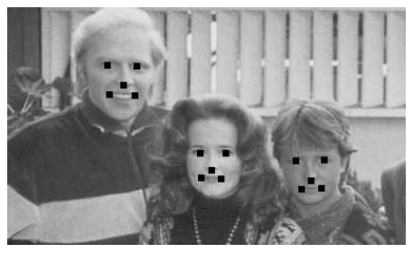
Recognition Results

Slide 24
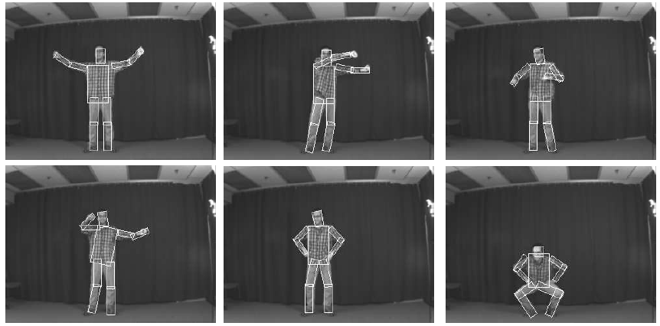
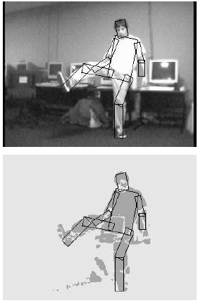
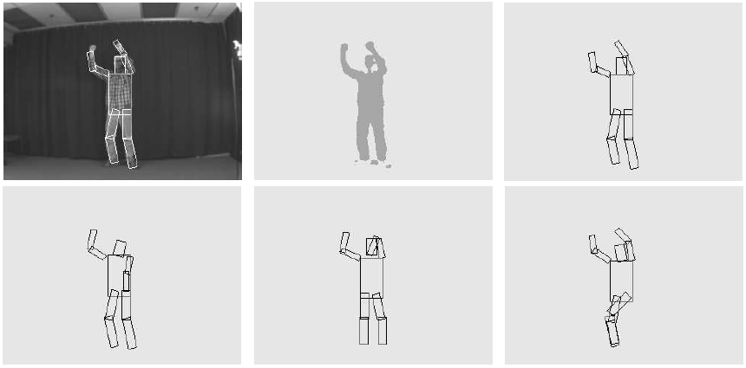
Recognition Results

Slide 25
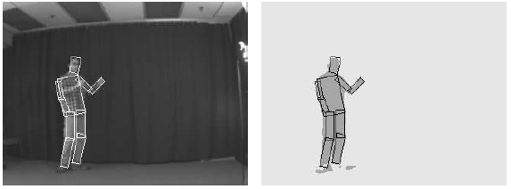
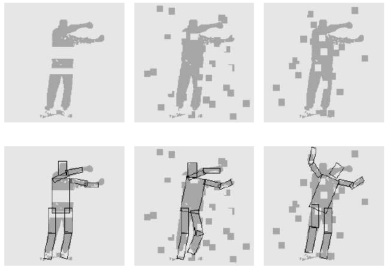
Recognition Results

Slide 26
Bayesian Network (BN)
Introduction
Pictorial Structures for Object Recognition
Topic Models (PRML05_Topic Models.pdf)

Slide 27
Outline
Introduction
Generative Models
Bayesian Network (BN)
Markov Random Field (MRF)
Sequential Models: HMM, DBN
Discriminative Models
Conditional Random Field (CRF)
Max-margin Markov Networks
Summary

Slide 28
Markov Random Field (MRF)
Introduction
Stereo matching
Image denoising

Slide 29
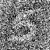
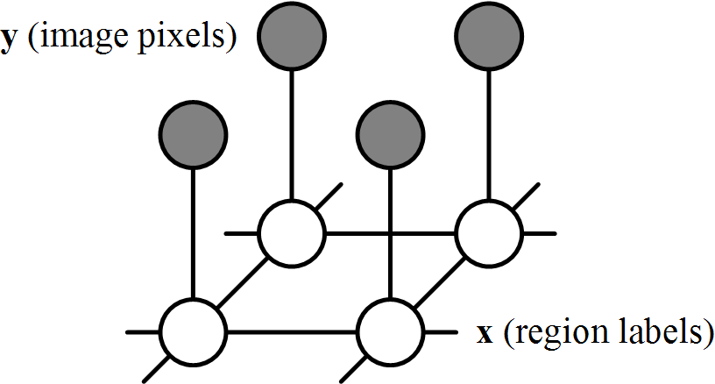

Markov Random Field (MRF)
Undirected Graphical Model
Undirected edges give correlations between variables
They can be used to model spatial constrains
spatial regularity of textures in a small region
smoothness of image regions
depth continuity in stereo construction
App: denoise, segmentation, stereo, ...
real image
1
label image

Slide 30
Site/Locations, Neighbors and Cliques
Let S be a set of sites, here for simplicity, assume S a grid: S={ (i, j) | i, j are integers }.
Cliques
A subset C of S is a clique if any two different elements of C are neighbors.
Neighbors
fully connected

Slide 31
Examples of neighborhood and cliques
8-neighborhood
cliques:

Slide 32
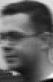
Random fields
The random vector on S is called a random field and assumed to have density p(x).
Images as Random fields: If vector X represents intensity values of an image, then its component X_{s} is the intensity value at location s=(i, j).
sites (pixels)
…
S=
…
X=
640x480
640x480

Slide 33
Markov Random Fields
If p(x) of a random field fulfills the so called Markov condition with respect to a neighborhood system, it is called a Markov Random Field.
I.E, the value X_{s} at site S is only depend on its neighbors.

Slide 34
Markov Random fields
p(x) can also be factorize over maximal cliques due to its Markov properties. i.e. Ψ_{C} is a function of of X determined by maximal clique C.
real image
1
label image

Slide 35
Markov Random Fields
MRFs are equivalent to Gibbs Fields and p(x) has the following form:
H(x) is called energy function.
The summation in the denominator is over all possible configurations on S. In our case are over all possible images. For 256 grey values and 640x480 grid, it will have 256^{640x480} terms. Z is impractical to evaluate.
so p(x) is only known up to a constant.

Slide 36
Markov Random Fields
real image
1
label image
max Pr(x,y) ≡ min E(x)
Energy function:
two constraints to satisfy:
Data Constraint:
Labeling should reflect the observation.
Smoothness constraint: Labeling should reflect spatial consistency (pixels close to each other are most likely to have similar labels).

Slide 37
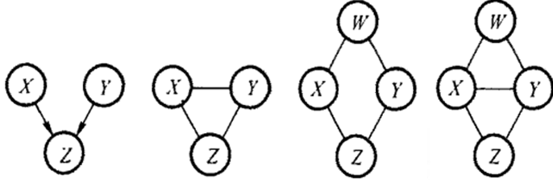
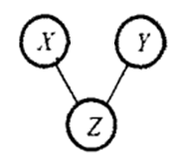
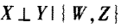
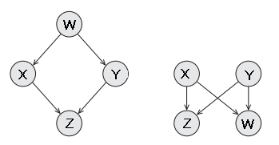
MRF vs. BN
P(X,Y,Z) = P(X)P(Y)P(Z|X,Y)
MRF can not do this factorization
P(X,Y,Z) = P(X,Y,Z)
P(X,Y,Z,W) = P(X,Z)P(Y,Z)P(X,W)P(Y,W)
BN can not do this factorization
P(X,Y,Z,W) = P(X,Y,Z)P(X,Y,W)
?
?

Slide 38
Inference in MRFs
Inference in MRFs
Classical:
Gibbs sampling, simulated annealing
Iterated condtional modes (ICM)
State of the Art
Graph cuts
Belief propagation
Tree-reweighted message passing

Slide 39
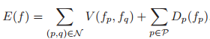
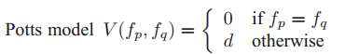
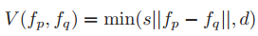
Markov Random Field (MRF)
Introduction
Stereo matching
Image denoising
Segmentation
Storeo/Denoise

Slide 40





Stereo matching
Labels
f_{p} ϵ {0, ... , k-1} correspond to different disparities
Window-based matching
(best window size)
MRF
Ground truth

Slide 41

Image denoising
Labels
f_{p} ϵ {0, ... , 255} correspond to intensity values

Slide 42
Outline
Introduction
Generative Models
Bayesian Network (BN)
Markov Random Field (MRF)
Sequential Models
Introduction
Hidden Markov Model (HMM)
Dynamic Bayesian Network (DBN)
Discriminative Models
Conditional Random Field (CRF)
Max-margin Markov Networks
Summary

Slide 43


From static to dynamic mixture models
State-space Models
Time series analysis
Sequatial data

Slide 44







Hidden Markov Model (HMM)
Hidden state q_{t}
q_{t} ϵ {S₁, ..., S_{N}}
Observation O_{t}
O_{t} ϵ {V₁, ..., V_{M}}
Three basic problems of HMM:
$$P\left(Q | λ\right)=P(q1)\prod_{t=2}^{T}{P(qt|q_{t−1})}$$

Slide 45

Dynamic Bayesian Network (DBN)
More general and expressive language for representing state-space models
An extension of BNs to handle temporal models
Time-invariant: the term ‘dynamic’ means that we are modeling a dynamic model, not that the networks change over time

Slide 46


Dynamic Bayesian Network (DBN)
Group Interaction Analysis in Dynamic Context

Slide 47








Group Interaction Analysis in Dynamic Context
Context
Situation
Presenter
Audio State
Questioner
Current
Speaker
ID
Talker
Role
from which
Loc?
Location
Body

Slide 48



Group Interaction Analysis in Dynamic Context
Context switch
Situation transition
Audio transition
Role transition
Location transition
Body transition

Slide 49

Group Interaction Analysis in Dynamic Context
Context switch
Situation transition
Audio transition
Role transition
Location transition
Body transition

Slide 50

Group Interaction Analysis in Dynamic Context

Slide 51

Group Interaction Analysis in Dynamic Context

Slide 52
Outline
Introduction
Generative Models
Bayesian Network (BN)
Markov Random Field (MRF)
Sequential Models
Introduction
Hidden Markov Model (HMM)
Dynamic Bayesian Network (DBN)
Discriminative Models
Introduction
Conditional Random Field (CRF)
Max-margin Markov Networks
Summary

Slide 53

Shortcomings of Hidden Markov Model

Slide 54

Generative vs. Discriminative

Slide 55

Structured Conditional Models

Slide 56
Outline
Introduction
Generative Models
Bayesian Network (BN)
Markov Random Field (MRF)
Sequential Models
Introduction
Hidden Markov Model (HMM)
Dynamic Bayesian Network (DBN)
Discriminative Models
Introduction
Conditional Random Field (CRF)
Max-margin Markov Networks
Summary

Slide 57


Conditional Random Fields
A random field model conditioned on inputs
Examples:
Chain structured
Grid structured

Slide 58

Chain structured CRF
HMM
CRF : Learn probability distribution from data
(Structured Learning)
Logistic Regression

Slide 59

Discriminative Learning from unstructured to structured
Conditional Random Fields: CRFs
maximum likelihood estimation
Logistic Regression
maximum likelihood estimation

Slide 60


Grid structured CRF

Slide 61

Grid structured CRF

Slide 62

Grid structured CRF

Slide 63

Grid structured CRF

Slide 64

Structure Detection/Classification

Slide 65


Slide 66
Outline
Introduction
Generative Models
Bayesian Network (BN)
Markov Random Field (MRF)
Sequential Models
Introduction
Hidden Markov Model (HMM)
Dynamic Bayesian Network (DBN)
Discriminative Models
Introduction
Conditional Random Field (CRF)
Max-margin Markov Networks
Summary

Slide 67

Discriminative Learning from unstructured to structured
Conditional Random Fields: CRFs
maximum likelihood estimation
Logistic Regression
maximum likelihood estimation
Support Vector Machines (SVM)
max-margin learning
Max-margin Markov Networks: M3Ns
max-margin learning

Slide 68
CRFs vs. M3N
Commons
have a Markov network to encode output structures
discriminative models dealing with arbitrary inputs
the kernel trick applies
can use various regularizors in learning
Differences
Log-loss versus structured hinge loss
Probabilistic versus non-probabilistic (normalization matters!)

Slide 69
Outline
Introduction
Generative Models
Bayesian Network (BN)
Markov Random Field (MRF)
Sequential Models
Introduction
Hidden Markov Model (HMM)
Dynamic Bayesian Network (DBN)
Discriminative Models
Introduction
Conditional Random Field (CRF)
Max-margin Markov Networks
Summary

Slide 70
Summary
Generative
Discriminative
MLE/MAP learning
Max-margin learning
Logistic Regression
SVM
Seq
Unstructured
BN
DBN (HMM)
Structured
Directed
CRF
Max-margin Markov Networks
Undirected
MRF

